Slide 1

Impacts on Human Health: HIV/AIDS and diseases Dr Jyoti K Sharma Professor & Head Center for Environmental Sciences & Engineering School of Natural Sciences

Slide 2
Impacts on Human Health: HIV/AIDS and diseases
I. Adverse effects of stressful environment on mental well being
II. Indirect effects of stressful environment on human health
III. Adulteration in food, medicines and human health
IV. Development and spread of disease causing organisms
V. Development and spread of vectors or carriers of serious diseases
VI. Direct effects of severe environment on human health
VII. Spread of HIV and AIDS

Slide 3
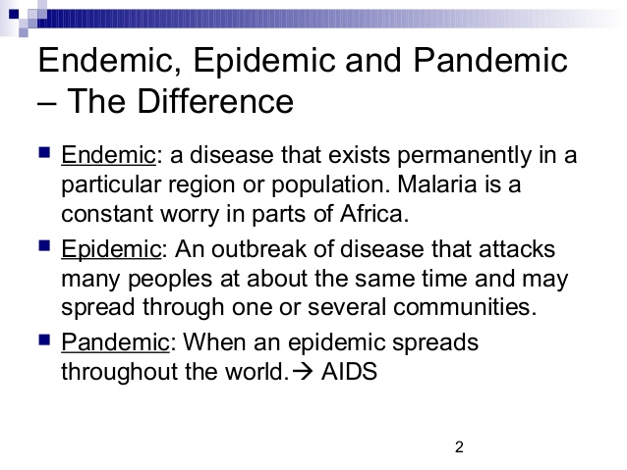
Human Diseases

Slide 4
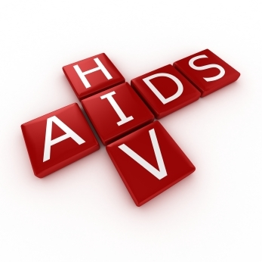
HIV AND AIDS DISEASES

Slide 5

HIV & AIDS

Slide 6
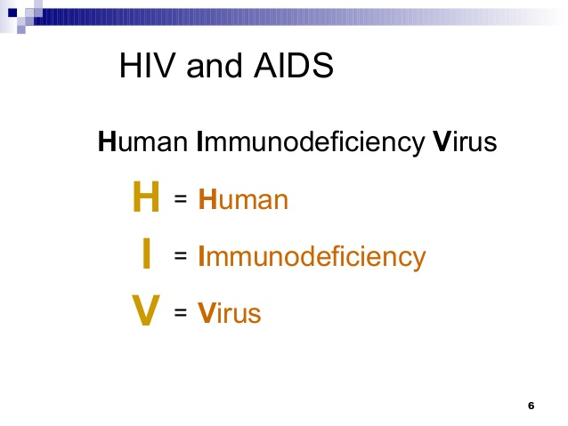
HIV and AIDS

Slide 7
HIV & AIDS
In 2016 about 36.7 million people were living with HIV and it resulted in 1 million deaths. There were 300,000 fewer new HIV cases in 2016 than in 2015. Most of those infected live in sub-Saharan Africa.
Between its discovery and 2014 AIDS has caused an estimated 39 million deaths worldwide. HIV/AIDS is considered a pandemic—a disease outbreak which is present over a large area and is actively spreading. HIV is believed to have originated in west-central Africa during the late 19th or early 20th century.
AIDS was first recognized by the United States Centers for Disease Control and Prevention (CDC) in 1981 and its cause—HIV infection—was identified in the early part of the decade

Slide 8
Human immunodeficiency virus infection and acquired immune deficiency syndrome (HIV/AIDS)
Human immunodeficiency virus infection and acquired immune deficiency syndrome (HIV/AIDS) is a spectrum of conditions caused by infection with the human immunodeficiency virus (HIV). Following initial infection, a person may not notice any symptoms or may experience a brief period of influenza-like illness.
Typically, this is followed by a prolonged period with no symptoms. As the infection progresses, it interferes more with the immune system, increasing the risk of common infections like tuberculosis, as well as other opportunistic infections, and tumors that rarely affect people who have working immune systems.
These late symptoms of infection are referred to as acquired immunodeficiency syndrome (AIDS).This stage is often also associated with weight loss.

Slide 9
What Are HIV & AIDS?
HIV~ (Human Immunodeficiency Virus) The virus compromises the body’s ability to handle disease and causes AIDS.
AIDS~ (Acquired Immune Deficiency Syndrome) It is related to HIV, but they are not one in the same. A person has AIDS only in the final stages of HIV, after the immune system becomes unable to defend itself against foreign invaders like bacteria, other viruses, and allows the development of certain cancers.

Slide 10
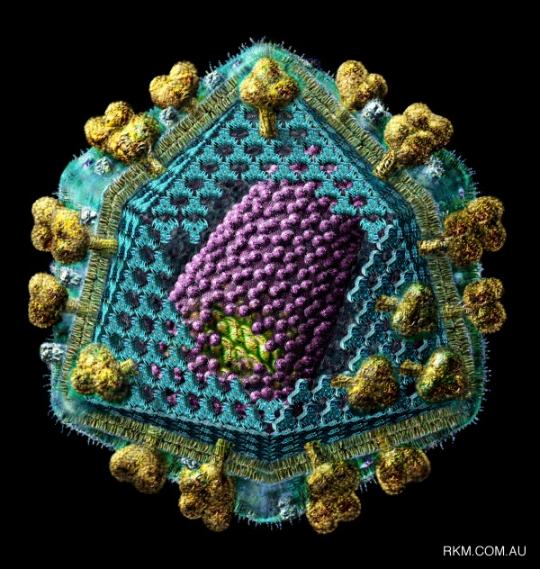
What is HIV?
Human Immunodeficiency Virus
an RNA based virus that causes AIDS
1. Attacks the Immune System
2. Destroys the body’s defenses against diseases
3. Body becomes vulnerable to infections & cancers
that don’t normally develop in healthy people
jschmied©2015

Slide 11
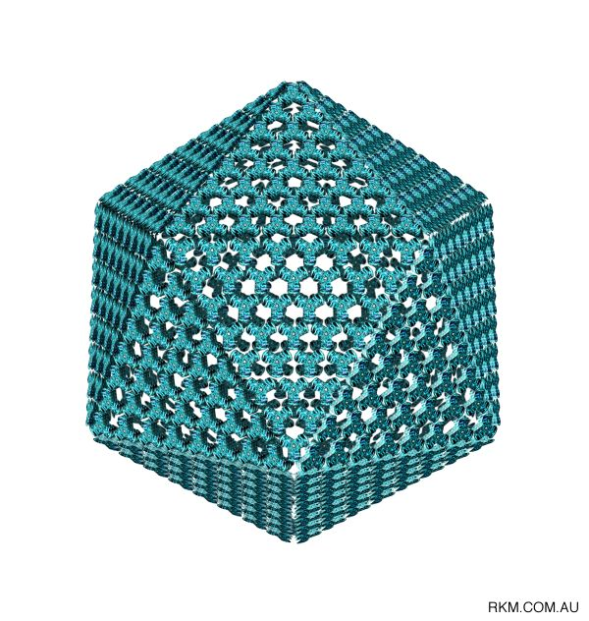
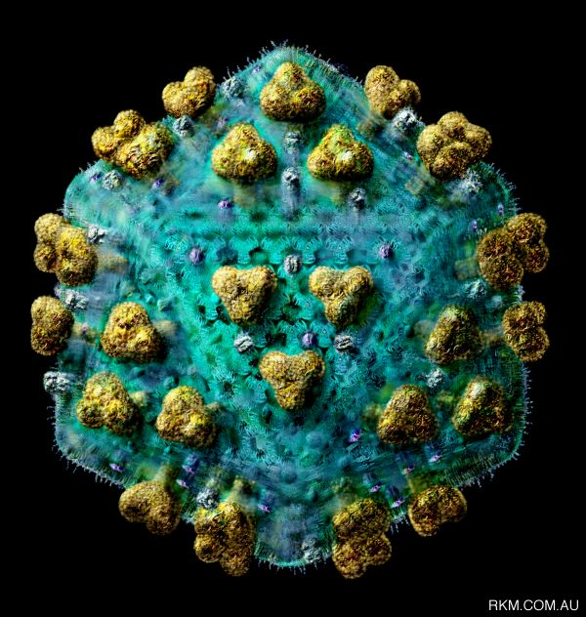
What does HIV look like?
HIV Capsule
HIV
jschmied©2015

Slide 12
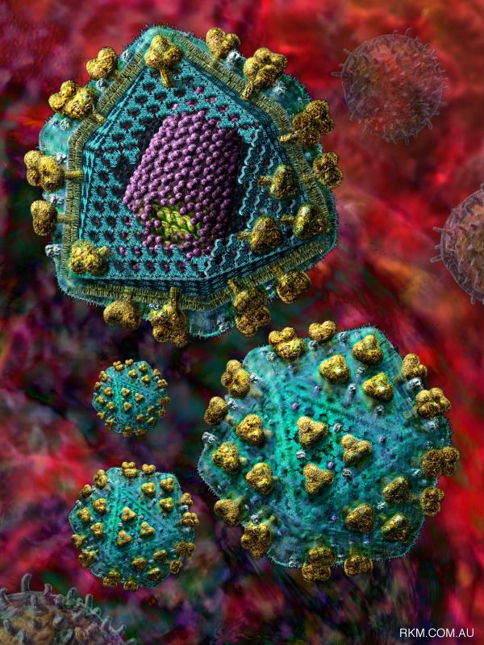
What does HIV look like?
A cut away
view of the virus.
jschmied©2015

Slide 13
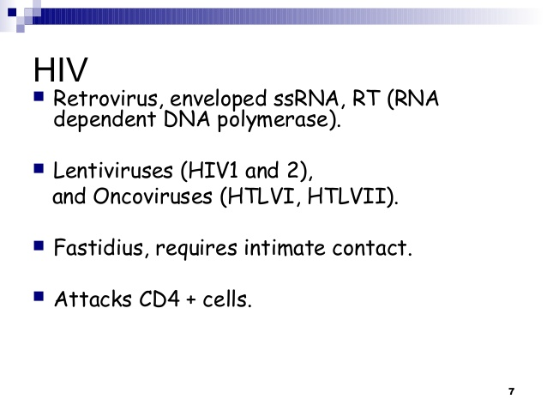
HIV

Slide 14
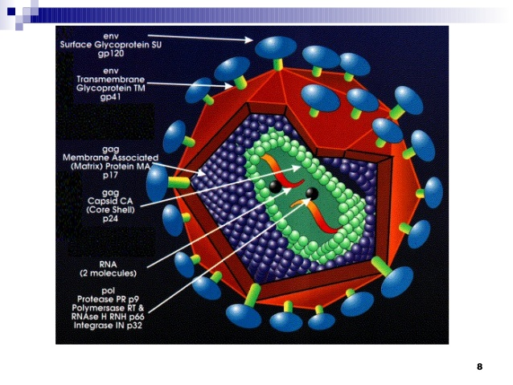
HIV

Slide 15
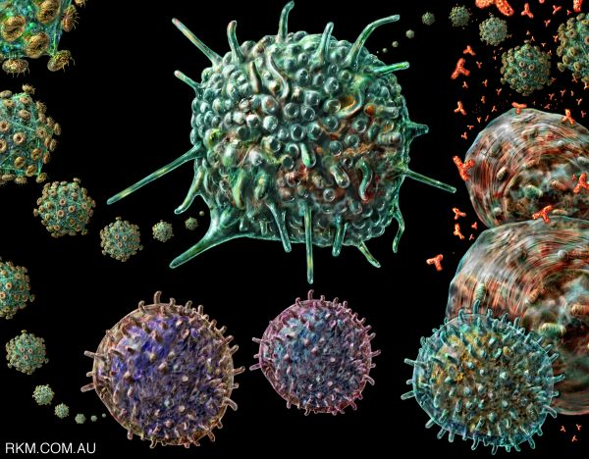
Two Key Parts of the Immune System
1. T4 or CD4 Cell
2. Antibodies
HIV

Slide 16
T4 0r CD4 Cells and Antibodies
T4/CD4 Cells
In molecular biology, CD4 (cluster of differentiation 4) is a glycoprotein found on the surface of immune cells such as T helper cells, monocytes, macrophages, and dendritic cells.
CD4+ T helper cells are white blood cells that are an essential part of the human immune system.
They are often referred to as CD4 cells, T-helper cells or T4 cells.
Antibodies:
An antibody (AB), also known as an immunoglobulin (Ig), is a large Y-shape protein produced by plasma cells that is used by the immune system to identify and neutralize foreign objects such as bacteria and viruses.
The antibody recognizes a unique part of the foreign target, called an antigen.

Slide 17
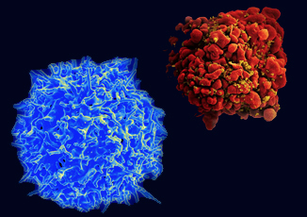
Healthy T Cell & Infected T Cell
HIV
Particles
(yellow)

Slide 18
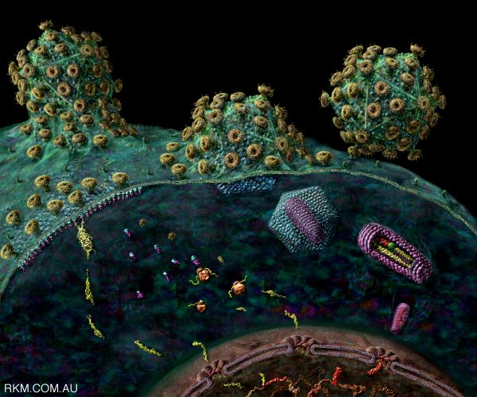
HIV Transmission
Requires:
1. Infected body fluid
AND
2. Entry into body

Slide 19
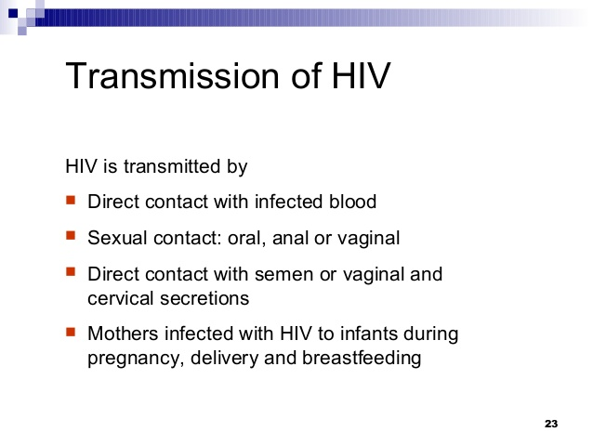
HIV Infection Transmission from one person to another

Slide 20
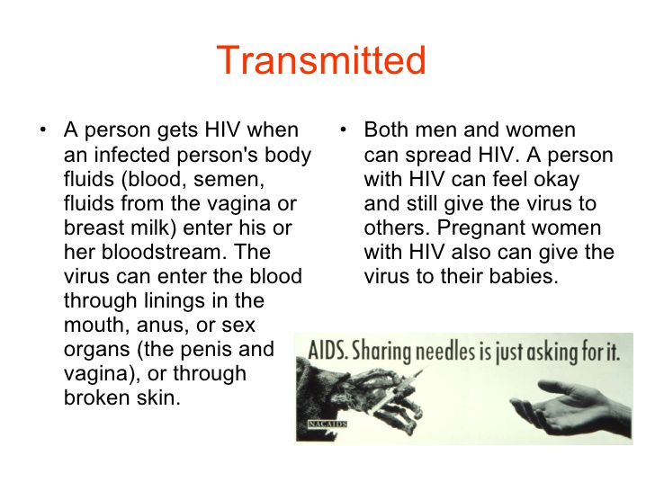
Transmission of HIV

Slide 21
Infected body fluids
Four Fluids, if infected, can transmit HIV
a. Blood
b. Semen
c. Vaginal Secretions
d. Breast Milk
If these enter the body

Slide 22
Which Fluids are safe?
Four Fluids that can’t transmit HIV
a. Spit/saliva
b. Pee/Urine
c. Sweat
d. Tears

Slide 23
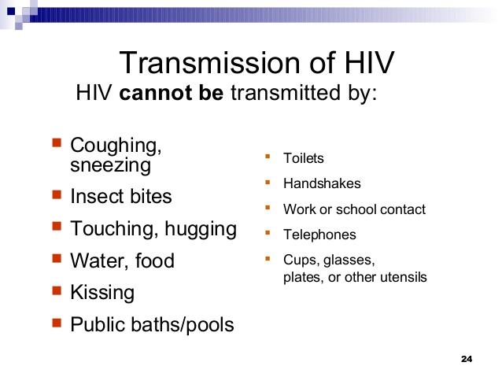
HIV Infection Transmission

Slide 24
How Does HIV get into a T Cell?
1. HIV attaches to
infection fighting T cell
2. Locks on to two entry
areas of the T cell
at once. (Keys in lock)
3. Tricks T cell to allow
Virus RNA to enter

Slide 25
What Does HIV do inside a T Cell?
1. Virus’s RNA changes into DNA
2. Enters Cell nucleus & becomes part of Host’s DNA!
3. Programs T cell to produce virus in abundance
4. New viruses bud off Host T cell, killing T cell, & enters bloodstream
5. New HIV viruses infect more T cells

Slide 26
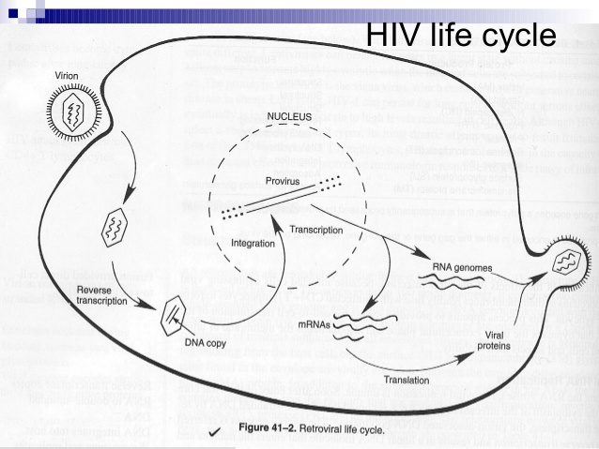
HIV LIFECYCLE IN HUMAN BODY

Slide 27
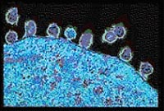
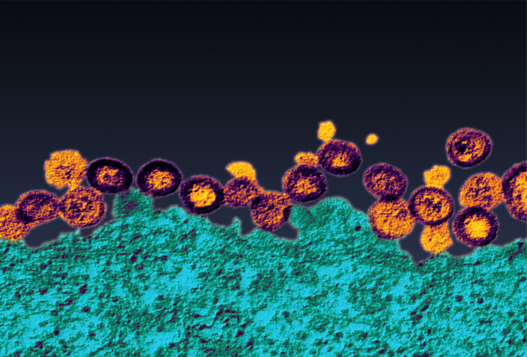
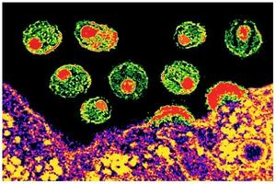
New HIV viruses leaving a cell

Slide 28
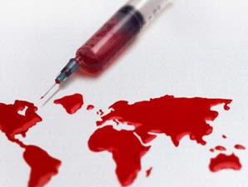
DIAGNOSIS
To be tested for HIV you usually give a sample of blood or a swab of fluids from your mouth.
It is recommended that if you are sexually active or have multiple partners you should be tested every 6 months.

Slide 29
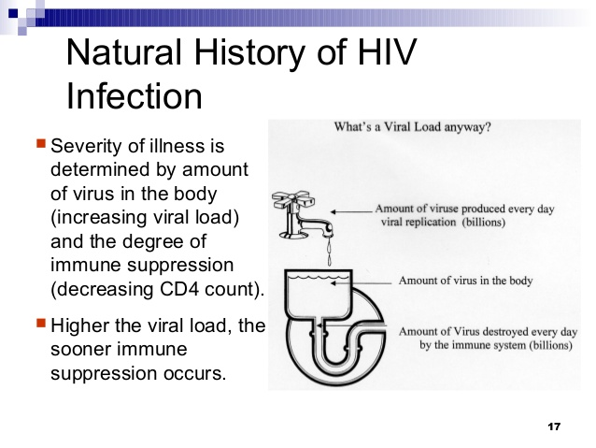
HIV Infection

Slide 30
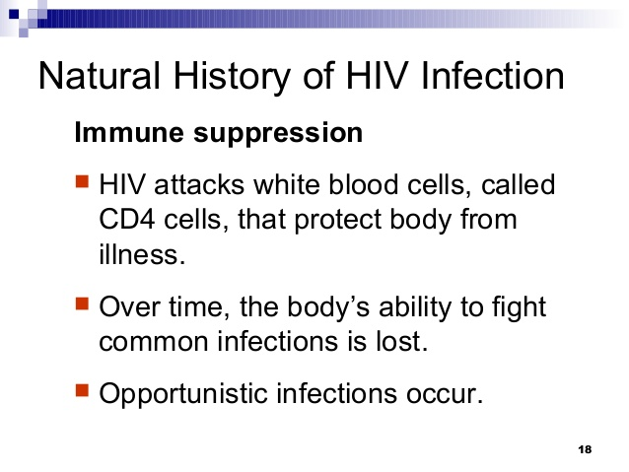
HIV Infection: Immune suppression

Slide 31
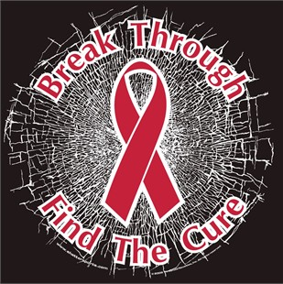

TREATMENT
There is no cure for HIV. Antiretroviral therapy (ARVT) can reduce the presence of the virus in the body, but can not eliminate it.

Slide 32
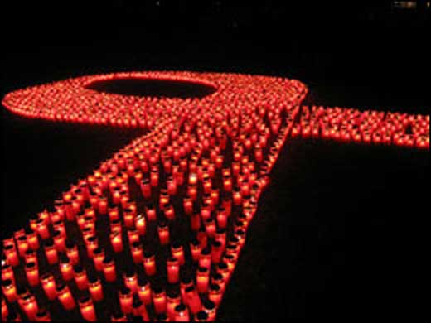
PROGNOSIS
The prognosis for those with HIV is improving with the development of antiretroviral drugs that help reduce the amount of HIV in the blood to an “undetectable viral load”.
ARVT are medications that treat HIV. The drugs do not kill or cure the Virus. However, they can prevent the growth of Virus and consequently further slowdown infection.

Slide 33
PREVENTION
To prevent HIV transmission during sex you need to use a condom.
HIV can be spread through vaginal, anal or oral sex.
Open sores from STDs like herpes & syphilis provide gateways for HIV to enter the body.
Gonorrhea & Chlamydia may weaken the skin & mucous barriers that help prevent infection.
If you inject drugs, use a new sterile needle each time to significantly reduce the risk of HIV transmission.

Slide 34
FACTS
HIV is not airborne and cannot be caught by touching skin, sweat or saliva.
You cannot get HIV by holding hands or sharing drinks.
Mosquito's do not inject other peoples blood when they bite and so can’t spread HIV.

Slide 35
What is the “Window Period?”
The time period between a person’s exposure & actual infection with HIV and until antibodies are detectable in the body.
After three months there are usually enough antibodies to show on an AIDS test.
Nearly all people (99%) develop antibodies by
THREE months.
jschmied©2015

Slide 36
HIV and the Immune System
A person can be HIV infected and not have AIDS if the person’s immune system is intact.
Often this period is from 8-10 years.
Has no symptoms, person is a carrier.
After this period, the immune system begins to lose the fight.
At this point the person has AIDS
jschmied©2015

Slide 37
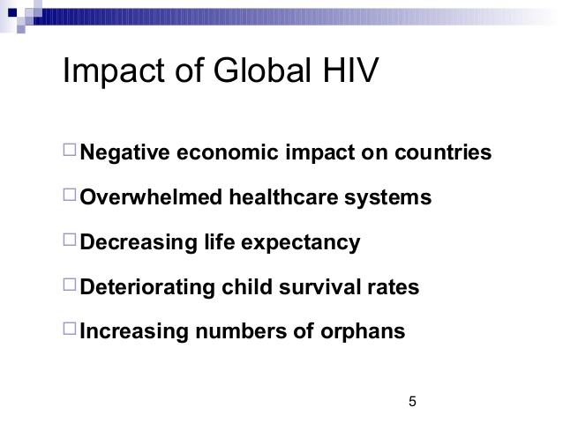
Impact of HIV in Countries

Slide 38
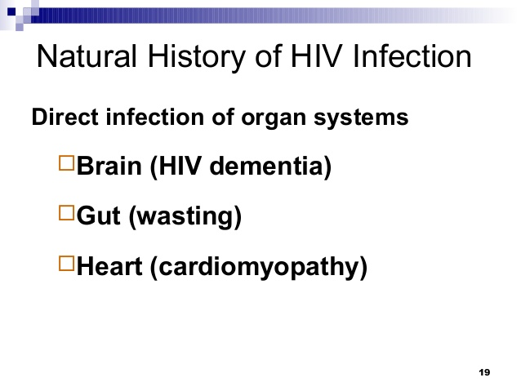
HIV Infection and body organs affected

Slide 39
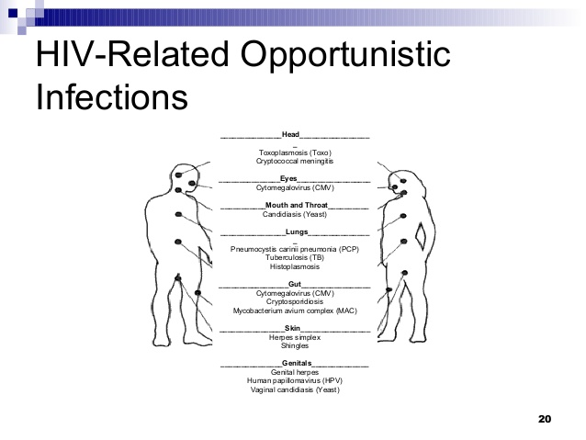
HIV Infection and body organs affected

Slide 40
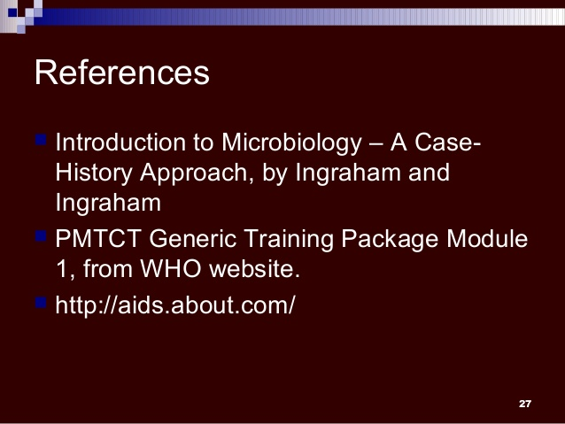
Literature

Slide 41
AIDS

Slide 42
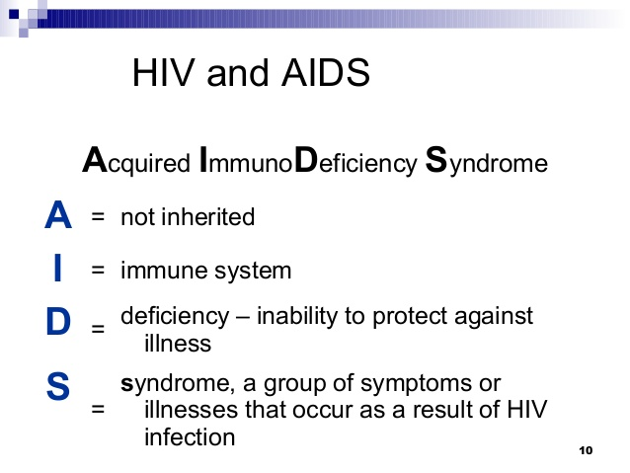
AIDS

Slide 43
ETIOLOGY
The world first became aware of AIDS in the early 1980’s.
Researchers aren’t sure exactly when and how HIV developed.
The most likely theories assume that HIV-1 was transmitted to humans from chimpanzees sometime in the early 20th century.

Slide 44
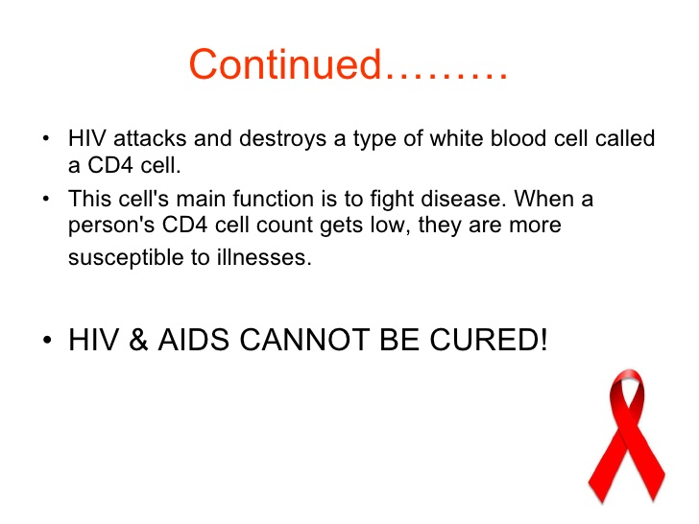
AIDS

Slide 45
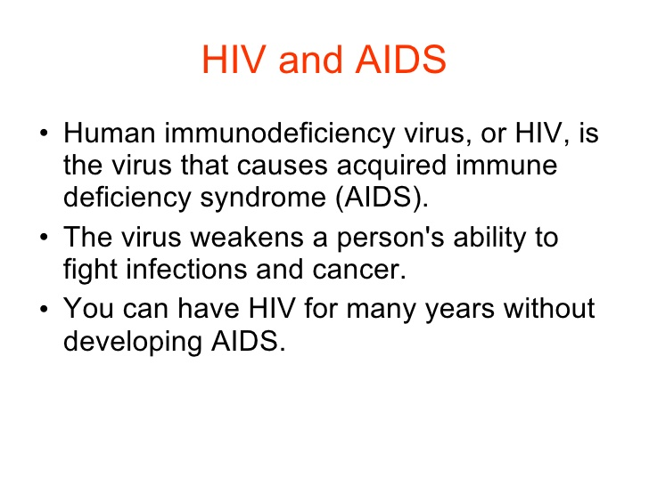
HIV and AIDS

Slide 46
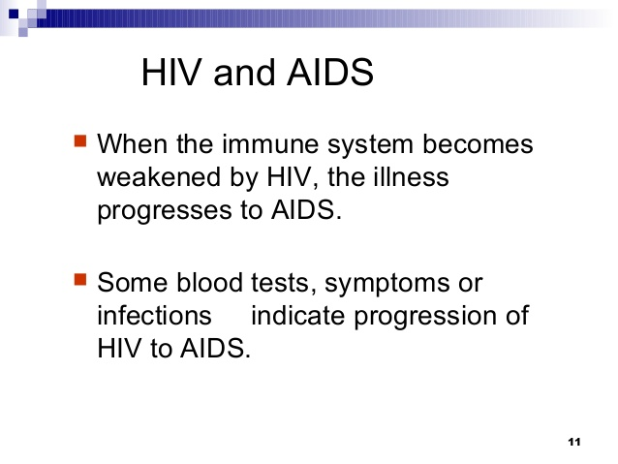
HIV and AIDS

Slide 47
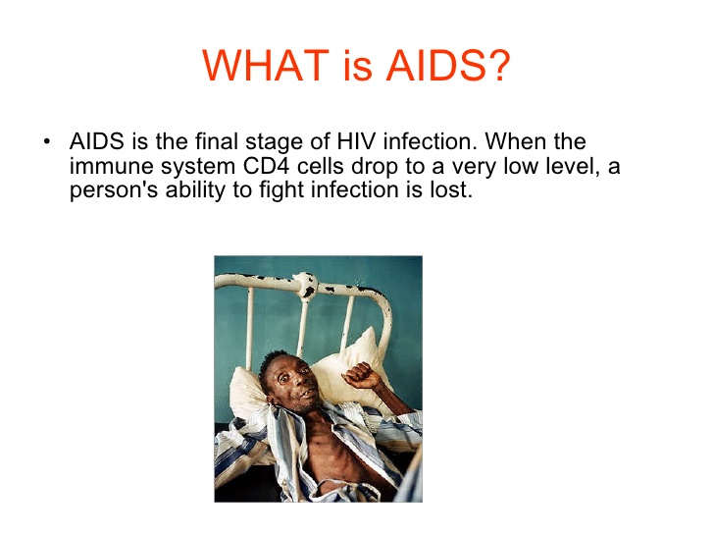
What is AIDS…..

Slide 48
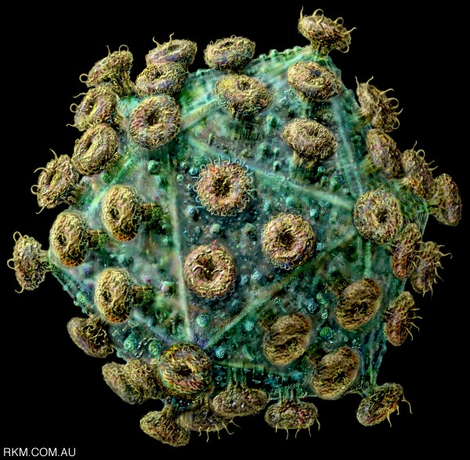
WHAT IS AIDS ??
1. The Late stage of HIV infection
2. A group of symptoms & signs of disease that occur together.
3. Severe immune system breakdown
4. Less than 200 T cells (or CD4 cells).
Normal 1000
j

Slide 49
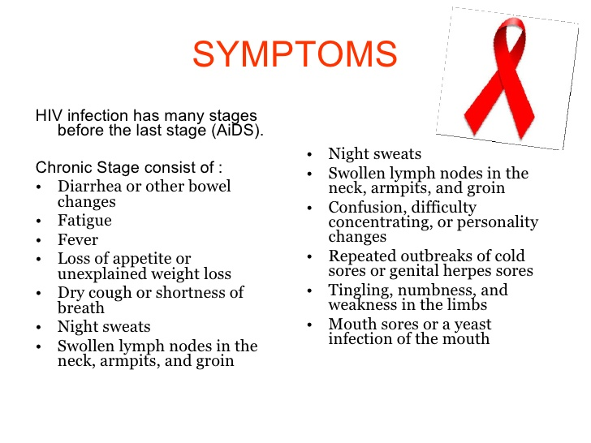
Symptoms of AIDS

Slide 50
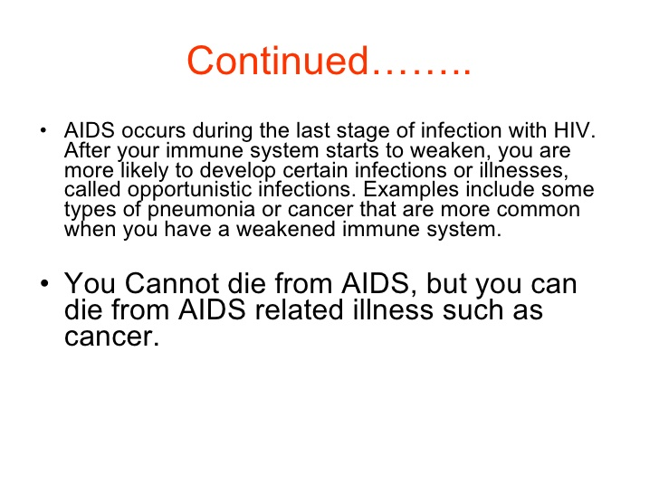
Symptoms of AIDS (Contd.)

Slide 51
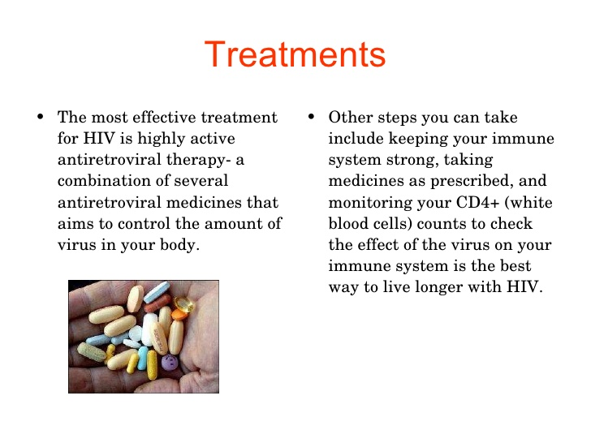
Treatment for HIV/AIDS

Slide 52
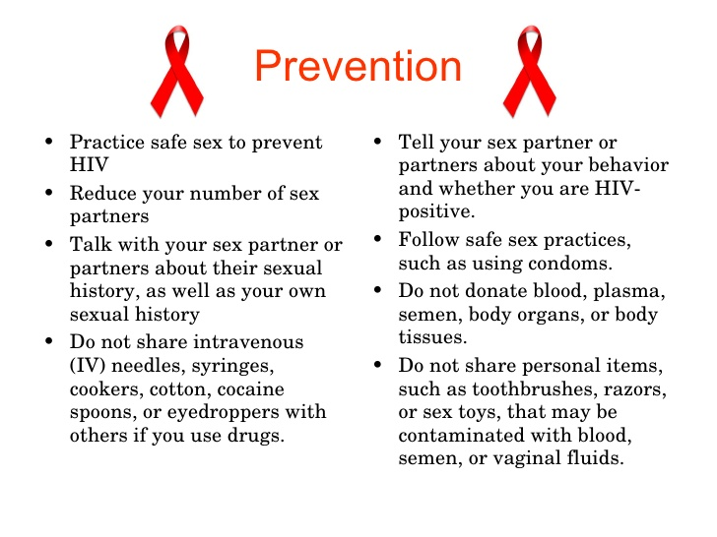
Prevention of HIV/AIDS

Slide 53
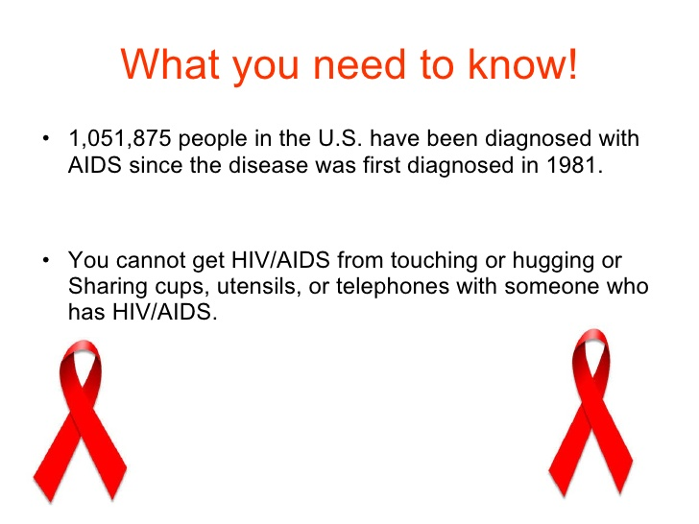
AIDS and its spread

Slide 54
What happens to someone with fully involved AIDS?
Immune system breaks down => Hospital ??
Cause of death - a variety of normally preventable diseases. Some are:
a. Pneumonia
b. Toxoplasmosis
c. Kaposi’s sarcoma
d. Mycobacterium Avium complex
e. Invasive cervical cancer
jschmied©2015

Slide 55
Treatment of AIDS & Life Expectancy
Treatment helps people live longer.
a. In 1993 = less than 7 years
b. In 2006 = 20 years or more…
….if properly treated
c. New drugs are the cause of the increase
2011: About 33.3 million people worldwide are infected with HIV, the virus that causes AIDS. In 2009, the last year for complete statistics, 2.6 million people became infected and 1.8 million people died.

Slide 56
What are the problems with Treatment?
a. Have to take lots of pills
b. Pills can make people sick – side effects
c. Pills don’t work for everyone – or forever
d. Pills cost lots of money!
2010 avg cost est. = $398,000 / 20+ years
or $1,659 / month
Advanced cases = $3,390 / month

Slide 57

Let’s Rewind!
Brainstorm respectfully:
What are 3 ways you can think of to keep
a person safe from HIV/AIDS???

Slide 58
Making Progress - AIDS by the numbers 33% decrease in new HIV infections since 2001 29% decrease in AIDS-related deaths (adults and children) since 2005 52% decrease in new HIV infections in children since 2001 40-fold Increase in access to antiretroviral therapy 2002–2012

Slide 59
How to keep safe?
1. No sex = abstinence
Have only one uninfected partner
= monogamy
3. Use protection = condoms
jschmied©2015

Slide 60
Thanks !!!

